Slide 1
Decode Java+DSA

Slide 2
Chapter 1 : Basics
Output
Variables & Operators
Variable naming rules
Comments
Input
Modulus Operator
Typecasting
Hierarchy
Char and ASCII

Slide 3
Chapter 3 : LOOPS
For Loop
Break and Continue
While and Do While Loop
Questions using Operators
Pattern Printing Problems

Slide 4


What and Why?

Slide 5
For Loop
for(int i = 1; i<10; i++){
// code
}

Slide 6
Ques : Print hello world ‘n’ times. Take ‘n’ as input from user

Slide 7
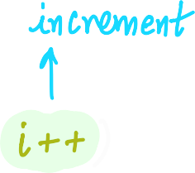


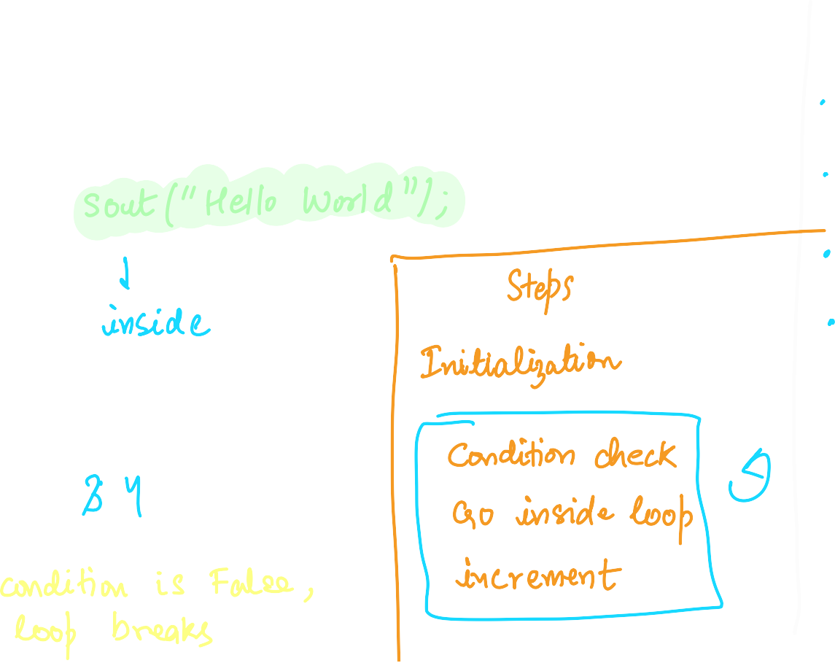

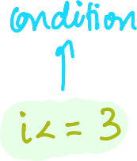










How for loop works : the various parameters.

Slide 8





Ques : Print numbers from 1 to 100

Slide 9




Ques : Print all the even numbers from 1 to 100

Slide 10







HW : Print all the odd numbers from 1 to 100

Slide 11




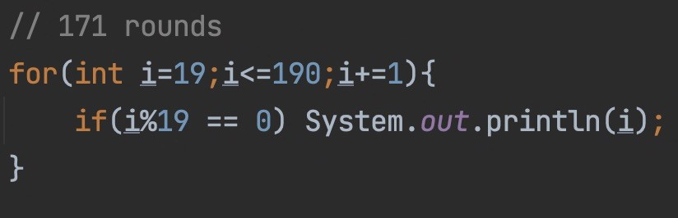
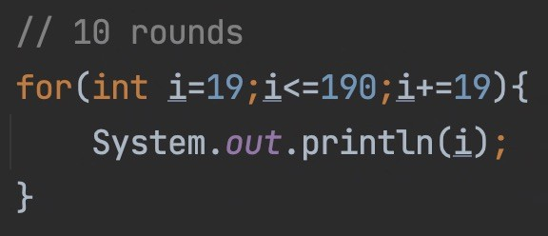


Ques : Print the table of 19.

Slide 12
HW : Print the table of ‘n’. Here ‘n’ is a integer which user will input.

Slide 13





Ques : Display this AP - 1,3,5,7,9.. upto ‘n’ terms.

Slide 14













Ques : Display this AP - 1,3,5,7,9.. upto ‘n’ terms.

Slide 15





HW : Display this AP - 4,7,10,13,16.. upto ‘n’ terms.

Slide 16









HW : Display this AP - 4,7,10,13,16.. upto ‘n’ terms.

Slide 17





Ques : Display this GP - 1,2,4,8,16,32,.. upto ‘n’ terms.

Slide 18
HW : Display this GP - 3,12,48,.. upto ‘n’ terms.

Slide 19



Break;

Slide 20






Ques : WAP to check if a number is composite or not.

Slide 21

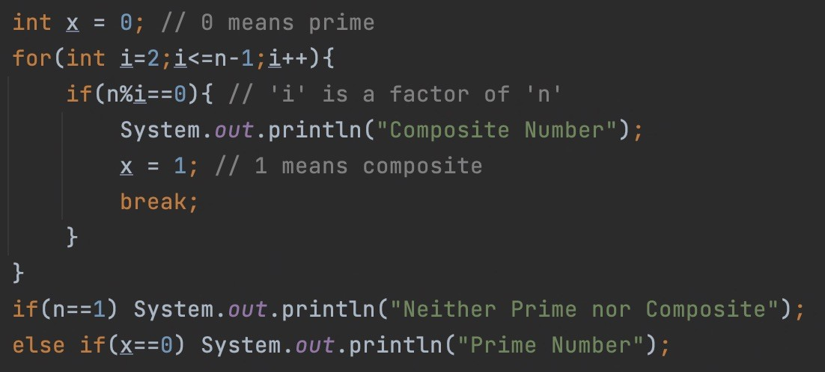
Ques : WAP to check if a number is prime or not.

Slide 22





Continue;

Slide 23
Ques : WAP to print odd numbers from 1 to 100.

Slide 24


While Loop
int i = 0; while(i<10){
// code i++;
}

Slide 25


Do- While
Loop
do {
//code
} while ( another == 'y' ) ;

Slide 26




Predict the output
int main( ) {
int x = 1 ;
while ( x == 1 )
x = x - 1 ;
System.out.print(x);
}

Slide 27





Predict the output
psvm(String[] args) {
int i ;
while ( i = 10 ) {
System.out.print(i); i = i + 1 ;
}
}

Slide 28

Predict the output
psvm(String[] args) {
while ( 'a' < 'b' )
System.out.println(“malayalam is a palindrome”);
}

Slide 29
HW : Predict the output
psvm(String[] args ) { int x = 4, y = 0; while ( x >= 0 ) {
x-- ; y++ ;
if ( x == y )
continue ;
else
System.out.println(x+” “+y);
}
}

Slide 30
Questions using Operators
+ - * /

Slide 31





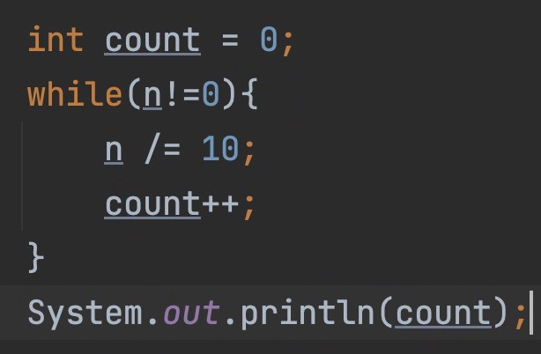


Ques : WAP to count digits of a given number.

Slide 32









Ques : WAP to print sum of digits of a given number.

Slide 33










Ques : WAP to print sum of digits of a given
number.

Slide 34










HW : WAP to print product of digits of a given number.

Slide 35

HW : WAP to print sum of all the even digits of a given number.

Slide 36












Ques : WAP to print reverse of a given number.

Slide 37






HW : WAP to print the sum of given number and its reverse.

Slide 38



Ques : Print the factorial of a given number ‘n’.

Slide 39







Slide 40


HW : Print the factorials of first ‘n’ numbers

Slide 41





HW : Write a program to print all the ASCII values and their equivalent characters of 26 alphabets using a while loop.

